Slide 1
Trends in State Funding Archivists Round Table OF Metropolitan New York, INC.
April 23, 2015
Maria Holden
New York State Archives

Slide 2
The value of grants!
Notes:
Thrilled to be here to share my thoughts about NYS grants and trends in state funding.
Grants are powerful generators for an organization
Energy, change, innovation, advancement, visibility, credibility
They really stretch your mind
Writing them is partly story telling—they don’t call it a narrative for nothing—demand creativity and the ability to spin your story in a compelling way
Managing them amazing hands-on lesson in planning, HR, budgeting, evaluation, reporting
I’m a naturally competitive person and I love the whole process
Apply for grants!
There are costs—there are people that say the costs neutralize the value
But intangible, incalculable benefits, like visibility and credibility, that often outweigh the costs

Slide 3
NYS Archives grant programs http://www.archives.nysed.gov/a/grants/index.shtml
Documentary Heritage Program
Local Government Records Management Improvement Fund
Hackman Research Residency Program
Notes:
I’ve spent most of my career in government archives, at the NY state archives
Conservator by training and early years focused on conservation and preservation management
Now I manage the Archives repository and also oversee the DHP program of grants and services to non-government repositories across NY
No matter what my job, always involved with grants:
Experience as a grant reviewer, grant project director, grant writer, and grant program administrator. Been there.
I come from a state agency that makes grants to archives and other organizations in New York that hold archives and records
Not here to justify or sell only our programs--later will tell you about grant opportunities
DHP—
The purpose the DHP grant program is to fill in the gaps in NY’s historical record and to make archival records accessible.
Our overarching goal is to ensure the documentation of undocumented communities and topics and access to that documentation.
DHP funds two types of projects:
Documentation projects focus on locating, identifying and acquiring unique historical records of under-documented topics and people. Records targeted in a documentation project are not yet in a historical records repository—they’re out there in community organizations, businesses, etc.
Arrangement & Description projects involve arranging and describing historical records that are already in a New York historical records repository and that has the capacity to make them accessible to the public.
These are small grants—perfect for the first time applicant
Grant awards range from $1,000-$25,000
Eligible applicants are non-government, non profit organizations—for A&D, you’re an organization that has archival records
Deadline tomorrow!
Here is a sampling of some recent NYC projects:
Centro arranged and described collections of individuals and organizations, most recently New York State Senator Olga Mendez, Cultural Advocate Elba Cabrera, Congressman Robert Garcia, and photographer Carlos Ortiz
SUNY Maritime Library - the records of the Marine Society of the City of New York
The River Project - a collection on marine science of the region, estuarine ecology, and the environment in New York State's waterways
New York Botanical Garden - 14,000 architectural plans of glasshouses from the Lord and Burnham Company collection
Storefront for Art and Architecture - Storefront's archives of programming records
Roundabout Theatre Company, Inc. - collection that documents the role the Selwyn Theatre in the revitalization of 42nd Street
New York University - the records of the New York Taxi Workers Alliance
Museum at Eldridge Street – records documenting the 1987-2007 restoration of the landmark synagogue on the Lower East Side
Citizens Housing and Planning Council of New York – documentation of the 20th Century history of New York City's built environment, and the policies that shaped it
LGRMIF grant program
supports records management and archives-related projects in local governments of all types and sizes throughout New York. In addition to the competitive grants program, the LGRMIF also supports disaster recovery grants
Eligible applicants include local governments: county, town, village, school districts, etc.
This program distributes more and larger grants. Funding level dependent on real estate transaction fees—so when market is down, the fund is down . In the order of 4 million per year, 1 million designated for NYC agencies
Hackman
The Larry J. Hackman Research Residency Program supports doctoral candidates, those at the postdoctoral level, and other scholars/researchers with awards for advanced research in New York State history, government, or public policy. The Residency Program at the State Archives in Albany and must involve records in our holdings.
Eligible applicant is an individual, not an organization
Travel grants, range from a few hundred to several thousand
A few projects:
Environment, Economy and Place: New Approaches to Conservation in New York Urban Cultural Parks
Sprawling Environmentalisms: Urban Housing, Open Space, and the Ecology of the Urban Crisis in New York City’s Forgotten Borough [Staten Island]
Science of Statecraft: The Skill of Measuring Land in New York State, 1784-1834

Slide 4
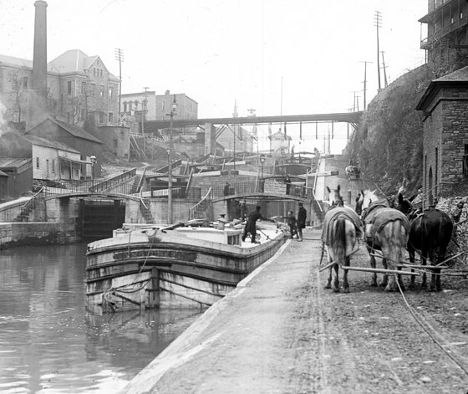
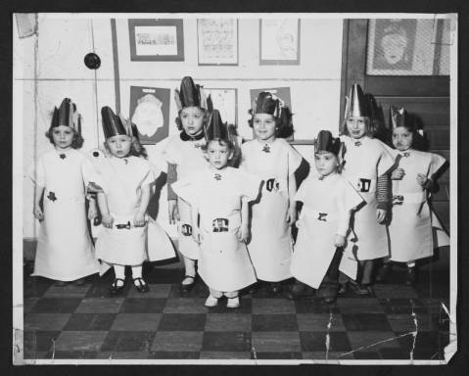
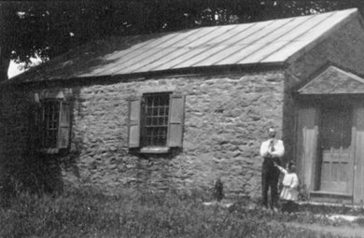
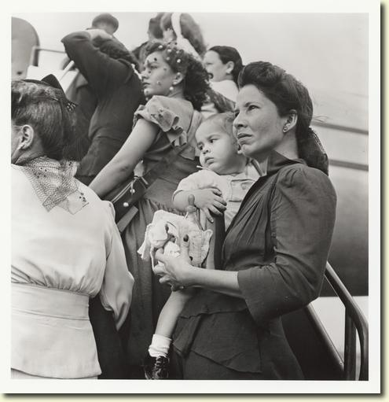
Four trends for success
Partnership/Shared services
Leveraging resources
Models
Sustainability
Notes:
I have the benefit of both a broad and long view—I’ve been in the field long enough to discern trends in approach and methodology that lead to successful projects.
These are the trends that bode well for the application, the project, and the applicant organization, for researchers, and for the broader archival community
Some of these themes we’ve actually hard wired in our LGRMIF program: we now have “shared services” and “demonstration” projects categories in that program
Show you these trends in action using some exemplary projects--these are groundbreaking projects leading to programs some of which wouldn’t have happened without a grant
Partnership/Shared services
Projects where applicant is a partnership and this partnership seeking support for services that will be shared by the partners. Feature diverse perspectives, economies of scale, and bigger impact.
2. Leveraging resources
Projects that continue to accrue support by finding creative ways to keep the momentum going—across disciplines.
3. Models
Projects that help other organizations achieve success by developing models to emulate. These projects produce a “how to” for other organizations.
4. Sustainability
Projects that don’t end when the grant runs out. Connect with stable structures or supports that sustain them.
Let’s look at exemplary projects that embody these attributes.

Slide 5
1. Partnership/Shared Services
Digital Towpath
http://digitaltowpath.org/content
Notes:
DT project that was established a few years ago with support from the State Archives. 5 grants totaling $479,000 Typically 5 collaborating applicants.
It’s a community cloud and e-government content management system. It provides local governments with tools to build web sites, manage electronic records, and provide email capacity to the many participating local governments it serves a region along the Erie Canal. Like the Canal, Digital Towpath provides infrastructure for community growth and prosperity.
Proposal represents collaboration—multiple applicants: consortium of academic and government orgs.
Administrative services are supported through partnership with the Institute for Local Government of SUNYIT.
Offers shared e-government services
Saves money
Makes it easy
Brings people together

Slide 7
2. Leveraging resources
El Centro de Estudios Puertorriqueños
http://centropr.hunter.cuny.edu/
Notes:
The Centro Archives collects, preserves and makes available for research unique primary sources that document the history and culture of the Puerto Rican Diaspora with a concentration on New York City. Among the collections are the records of community based organizations and the papers of activists, writers, artists, scholars, educators and elected officials.
Since the he archives was founded in 1989, it has become a repository recognized world-wide for documenting Puerto Ricans’ experience in United States.
Strategic grant funding played a large part in Centro’s growth: They obtained several DHP grants, NYS C/P Preservation grants, foundation grants, federal grants from NHPRC and NEH to fuel their growth
Started small, building on their success, incrementally and in measured steps. They found the right grants for their needs: documentation, description, preservation, online access tools, digital access
A few years ago Centro partnered with NYS Archives and several other repositories on the NEH-funded Ventana al Pasado project to create bilingual finding aids for some 300 collections relating to Latino Hispanic history in New York and digitize some 3,000 images.

Slide 8
2. Leveraging resources
Holland Patent Central School District
Notes:
Twelve miles north of Utica is the Holland Patent Central School District and teacher center. For almost 20 years, with LGRMIF grants from the NYS Archives, the district and teacher center worked to identify primary sources in their community and to integrate these resources in the classroom.
Using school enrollment records, maps, oral histories from residents, many elderly, fourth graders researched the history of their school district from the era of rural one room schoolhouses to centralization in the 1930s.
This is the original Wethersfield School in the HP community. Built in 1825, it operated as a school house until 1939.

Slide 9
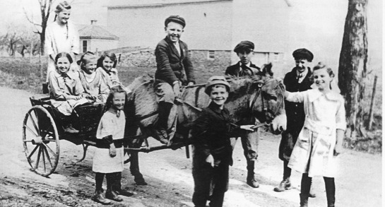
Notes:
Student researchers discovered that no one attending any of the district’s one room schoolhouses had to walk up hill both ways!
And, no one had to walk more than a mile to their assigned school house.
They learned that observing, listening and investigating are valuable skills that help them develop an informed perspective on a topic.

Slide 10
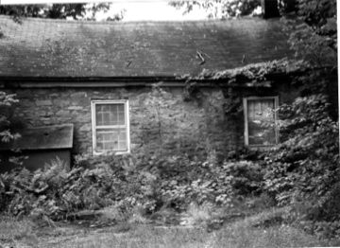
Notes:
Enter the Wethersfield School--close by and intact, barely.
Building on the energy and enthusiasm of the 4th grade students, the community rallied and set a goal to preserve the Wethersfield School and make it a community resource.

Slide 11
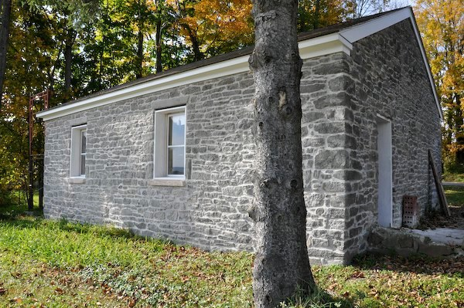
Notes:
Fast forward to today, the building’s rehab is almost done. The school and land were deeded to the society, an architectural firm hired, work donated and the school listed on the National and State Historic Registers. Now a community meeting facility.
This particular local history activity continues to be a magnet for community participation.

Slide 12
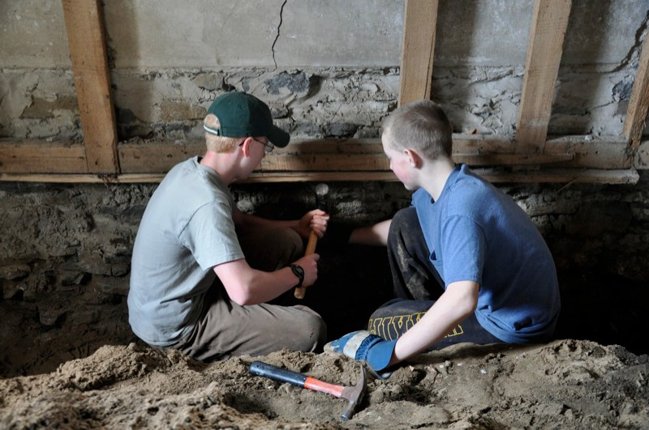
Notes:
The preservation was an eagle scout project. This is but one example of the power of a relatively modest grant to leverage intergenerational learning, a major historic preservation project, and community building around a source local pride.

Slide 13
3. Models
Tompkins County, NY
http://www.tompkinscountyny.gov/tsserr
Notes:
Tompkins Shared Services Electronic Records Repository is a group created to provide, oversee, and coordinate shared records management within Tompkins County
This is part of the Tompkins County website, the one-stop, online community resource for Tompkins County.
The Tompkins County website provides convenient access to Tompkins County information and services, and makes it easier than ever to do business with Tompkins County.
This is a demonstration project that has received support from the State Archives. A project all about creating a model that can be used by other governments. A project to show another repository how to do something. This is how you do it.
Document process, roles, responsibilities. Create a recipe. More important then the finished product.

Slide 14
4. Sustainability
Jewish Buffalo Archives Project
http://library.buffalo.edu/archives/jbap/
Notes:
The Jewish Buffalo Archives Project is building a collection of historical records of the Jewish communities of Greater Buffalo.
Their goal is to save and preserve these materials so future generations will be able to learn and grow from the legacy of forebears.
They collect: Family papers, Diaries, memoirs, scrapbooks, photographs, Business and organizational records, and Oral histories.
This project started about under ten years ago as just a concept
Documentation process was supported by two DHP documentation grants, 2008 and 2011
Project obtained matching monies from the Foundation for Jewish Philanthropies and
Funding from Western NY LRC
One of the requirements of a DHP documentation project is to find a repository
That repository is U Archives at UB
Deposited records there--130 CF in 2012
Digital collection launched on NY Heritage ca. 300 images
Trajectory here--From an notion to a physical collection of well over 100 CF to an archives that is housed at a major research library where it will be preserved and made available for research.
And the project is still going strong,
AND STILL COLLECTING!

Slide 15
4. Sustainability
Shoulders to Stand On:
Documenting Rochester’s LGBT History
Notes:
Series of three consecutive DHP documentation grants from 2009-2012 built a collection documenting LGBT history in Rochester
Gay Alliance of the Genesee Valley
Documented the history of the LGBT community in Rochester.
Surveyed 137 organizations 120 CF
Identified hundreds of organizations—potential records sources/creators
ID’d and placed in repositories 19 series from gay organizations
Repositories: Cornell and University of Rochester
Created finding aids
Used Empty Closet, oldest continuously published gay newspaper in NY for outreach about the project and the importance of records
Ongoing projects:
Writing and publishing a history
Documentary film: Shoulders to Stand On
Oral histories
Educational kit
Free screenings in public libraries—to connect w undocumented and underserved population in the LGBT community
Empty Closet Newspaper digitized 2010—U of R
What makes this project sustainable?
Committed leaders
Found robust, reliable structures and systems to perpetuate the effort:
Stable repositories in Cornell and U Rochester
Newspaper for continuous reporting and outreach
And like the Buffalo Jewish Archives Project, still collecting

Slide 16
Grant opportunities in New York
Basic program building
Collections
Public programming
Research
Museum Association of New York Mini- and Travel Grants
New York Council for the Humanities Vision Grant
William G. Pomeroy Foundation Professional Development Grant
Notes:
Opportunities—not exhaustive!
What is basic program building?
Planning
Policies and procedures
Staff development
Advocacy
MANY
Mini-grants—board, audience, membership, or program development; strategic or long-range planning; staff training, marketing, exhibitions, collections, or museum education. Traditional consultancies as well as mentoring relationships are welcome. Up to 5k
Travel.
to view exemplary exhibitions, collections management projects or interpretive programs in New York State.
• Travel and registration fees for professional conferences or workshops in New York State and beyond
• Travel to conduct research in New York State related to your institution's collections or exhibitions.
• Registration fees for online training courses & in-person classes
Up to 1k
NYCH—$1,500 to develop ideas for public humanities programs that are built in partnership with your community
The William G. Pomeroy Foundation will offer 10 competitive need based scholarships of $1,000 each for historical societies in New York State for professional development.

Slide 17
Grant opportunities in New York
Basic program building
Collections
Public programming
Research
NYS Archives Documentary Heritage Program
NYS Archives Local Government Records Management Improvement Fund
NYS Library Conservation/ Preservation Program
Greater Hudson Heritage Conservation Treatment Grant Program
Regional Bibliographic Data Bases Grant Program
NYS Parks Historic Preservation Program
Preservation League of New York State
Notes:
What do I mean?
Conservation
Disaster prep
Storage environment improvements
Security
Records management
Inventory
Collection development
Documentation
A&D
Digitization
NYS Library Conservation/Preservation
Conservation treatment and rehousing, reformatting, surveys, etc.
GHHN
Conservation of wide range of artifacts—not just archives
RBDB—State funds administered by the 3Rs Library Councils to fund digitization, metadata, retrospective conversion
Grants tend to be less than $20,000
The activities listed below may be carried out by the system, through member projects, or a combination of both.
Historic Preservation grants—for those archives stored in a historic building
Landmarks Conservancy—houses of worship

Slide 18
Grant opportunities in New York
Basic program building
Collections
Public programming
Research
Museum Association of New York Mini- and Travel Grants
NY Council for the Humanities Action Grant
Notes:
What do I mean?
Exhibits
Educational Uses of Records
Public events
Educational Services
MANY Mini—board, audience, membership, or program development; strategic or long-range planning; staff training, marketing, exhibitions, collections, or museum education. Traditional consultancies as well as mentoring relationships are welcome. Up to 5k
Travel.
to view exemplary exhibitions, collections management projects or interpretive programs in New York State.
• Travel and registration fees for professional conferences or workshops in New York State.
• Travel to conduct research in New York State related to your institution's collections or exhibitions.
•
• Registration fees for online training courses & in-person classes
Up to 1k
NYCH Action $5,000 to launch humanities programs that are dynamic and address meaningful issues across the state. Examples
Convene a town hall focused on an issue that resonates with your audiences
Publicize an exhibition built upon a humanities framework that is both informative and engaging
Launch a series of lectures coordinated in partnership with other groups active in your area

Slide 19
Grant opportunities in New York
Basic program building
Collections
Public programming
Research
NYS Archives Hackman Research Residency
Gilder-Lehrman Institute Fellowship/Scholar Award
William G. Pomeroy Foundation
Museum Association of NY Travel Grant
Notes:
Hackman
Gilder Lehrman
short-term research fellowships in the amount of $3000 each to doctoral candidates, university faculty, and independent scholars working in the field of American history. This year, preference will be given to applicants whose research is focused on primary sources in the Gilder Lehrman Collection.
Pomeroy
MANY

Slide 20
